Slide 1
A presentation on Digital Marketing at Xdezo Technologies Pvt. Ltd
SUBMITTED BY: SUSHMITA GURUNG
EXAM ROLL NO: 12286/20

Slide 2
Contents
Introduction to Organization
Objective of Internship
Introduction to Project
Activities performed
Screenshots
Conclusion

Slide 3
Introduction to Organization
XDezo Technologies Pvt. Ltd. is an IT company based in Pokhara, Nepal, started in 2019. They focus is on provide high-quality IT training and digital solutions, empowering individuals and businesses in the digital era.
As a subsidiary of XDezo Technologies, XDezo Academy serves as the educational branch, providing a range of courses designed to meet the demands of the modern tech industry. The academy offers programs in full-stack web development (PHP Laravel, Python Django, MERN), mobile app development, UI/UX design, graphics design, and digital marketing . Emphasizing hands-on learning, XDezo Academy ensures that students gain real-world experience through project-based training and mentorship.
The CEO, Dinesh Thapa, has about years of experience in advanced tech like AI and big data. He wants to provide high-quality courses and help students build strong tech careers.
XDezo has trained over 5,000 students, works with more than 15 colleges in Pokhara, and helps students find jobs and internships after training.

Slide 4
Objectives of Internship
To explore interest in a career before choosing it for the future.
To become familiar with the workplace and the industry.
To provide an in-depth knowledge of formal functional activities of the organization.
To develop practical skills and techniques directly applicable to their career.
To provide an opportunity to test abilities in a particular field.

Slide 5
Introduction to Project
The internship project was designed to provide real-world exposure to the field of digital marketing and enhance practical skills through hands-on experience.
It was undertaken at XDezo Technologies, a technology company based in Pokhara, known for its services in web development, digital marketing, and IT training.
The primary goal of the project was to bridge the gap between classroom learning and industry practices in the digital marketing domain.
Digital marketing plays a crucial role in modern business strategy by enabling organizations to reach and engage with their audiences more effectively through online channels.
Through this internship, I aimed to observe and understand the application of digital marketing strategies in a professional setting.
The project also helped me gain insight into the structure, workflow, and digital practices followed by a tech-based company.
Overall, the internship project served as a foundation for professional development and a stepping stone toward a career in the digital marketing industry.

Slide 6
Activities Performed
Built backlinks through social bookmarking sites
Write SEO-optimized content for websites and blogs
Website Ranking and SEO Optimization
Managed Google My Business profiles
Designed and scheduled posts for Facebook and Instagram using Canva.
Analyzed competitor ads using Meta Ads Library (Facebook Ads Library)
Monitored website traffic with Google Analytics
Tracked search performance with Google Search Console.

Slide 7
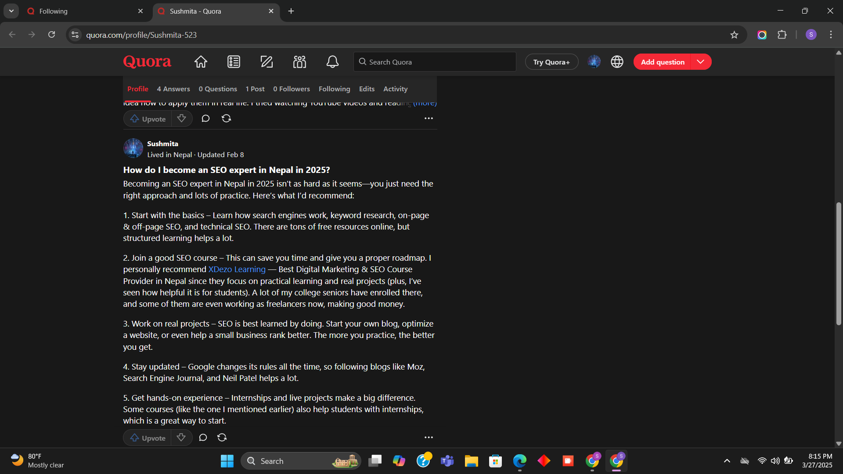
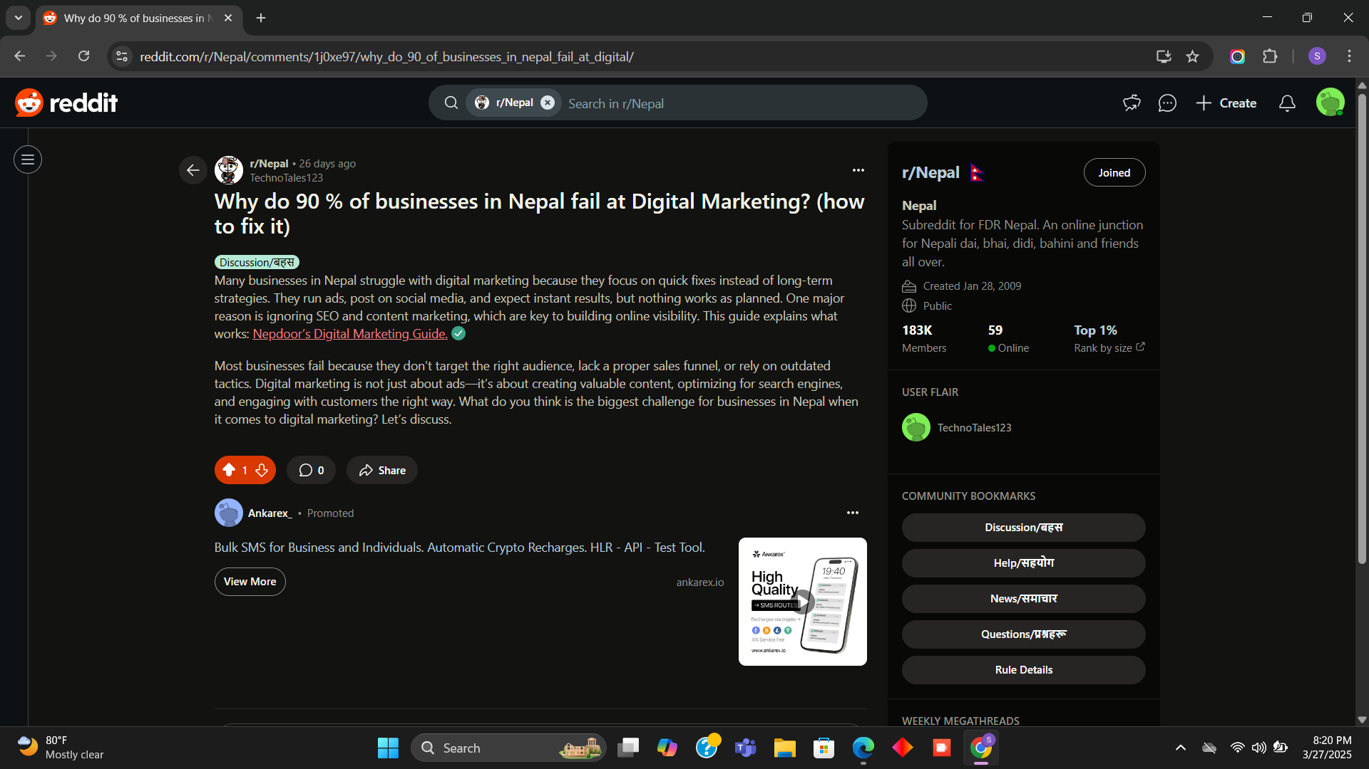
Screenshots

Slide 8
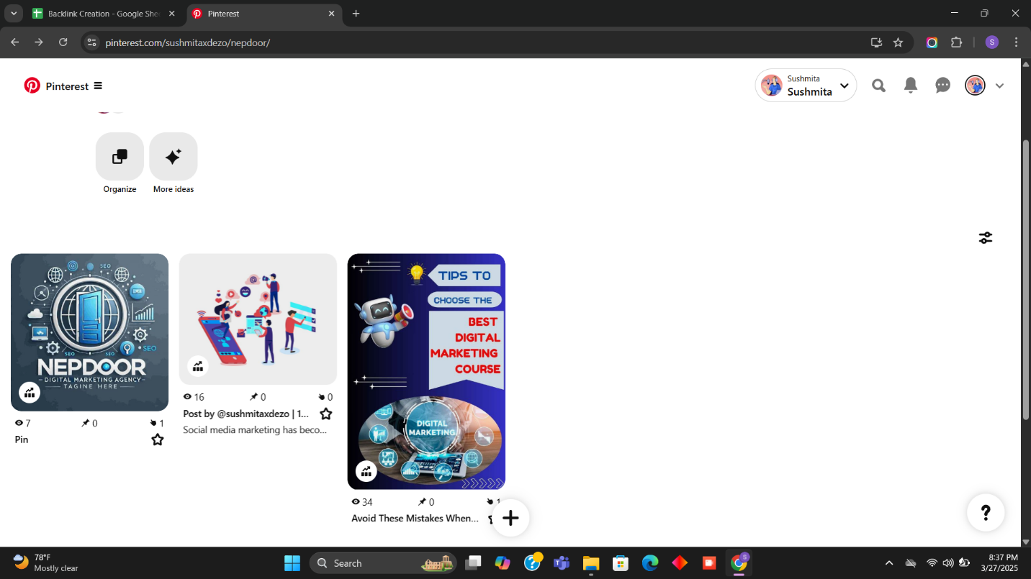


Slide 9
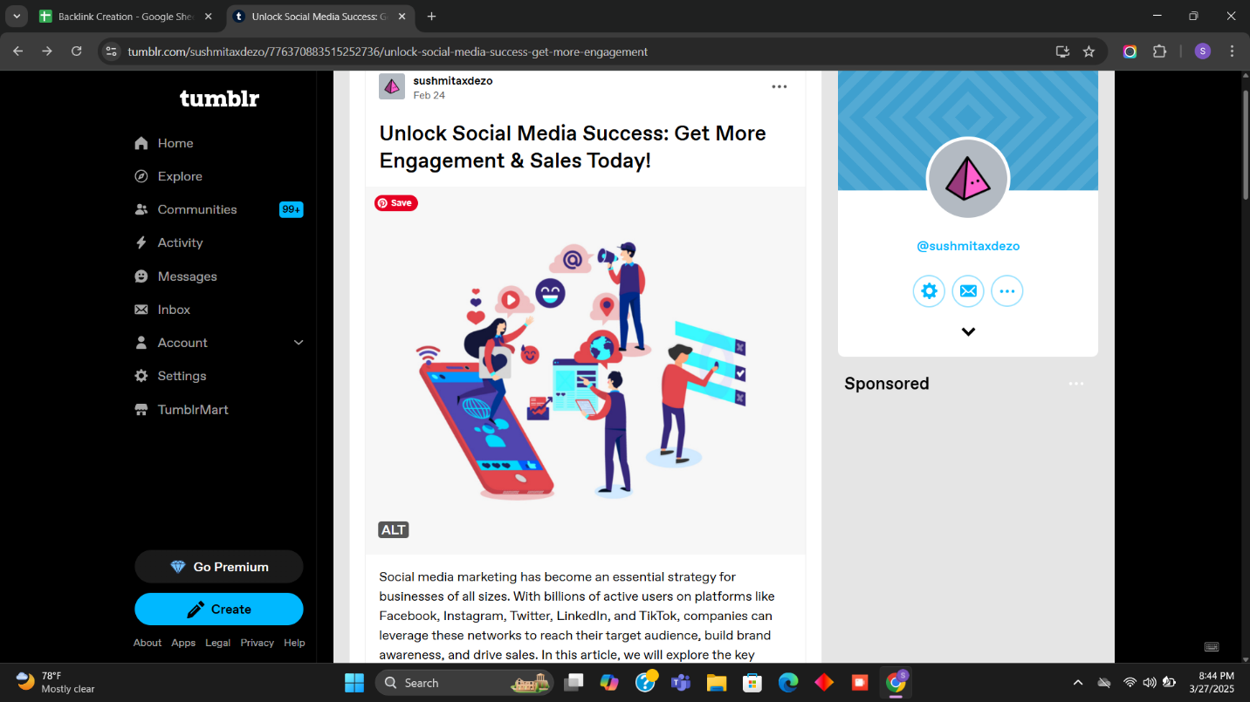

Slide 10
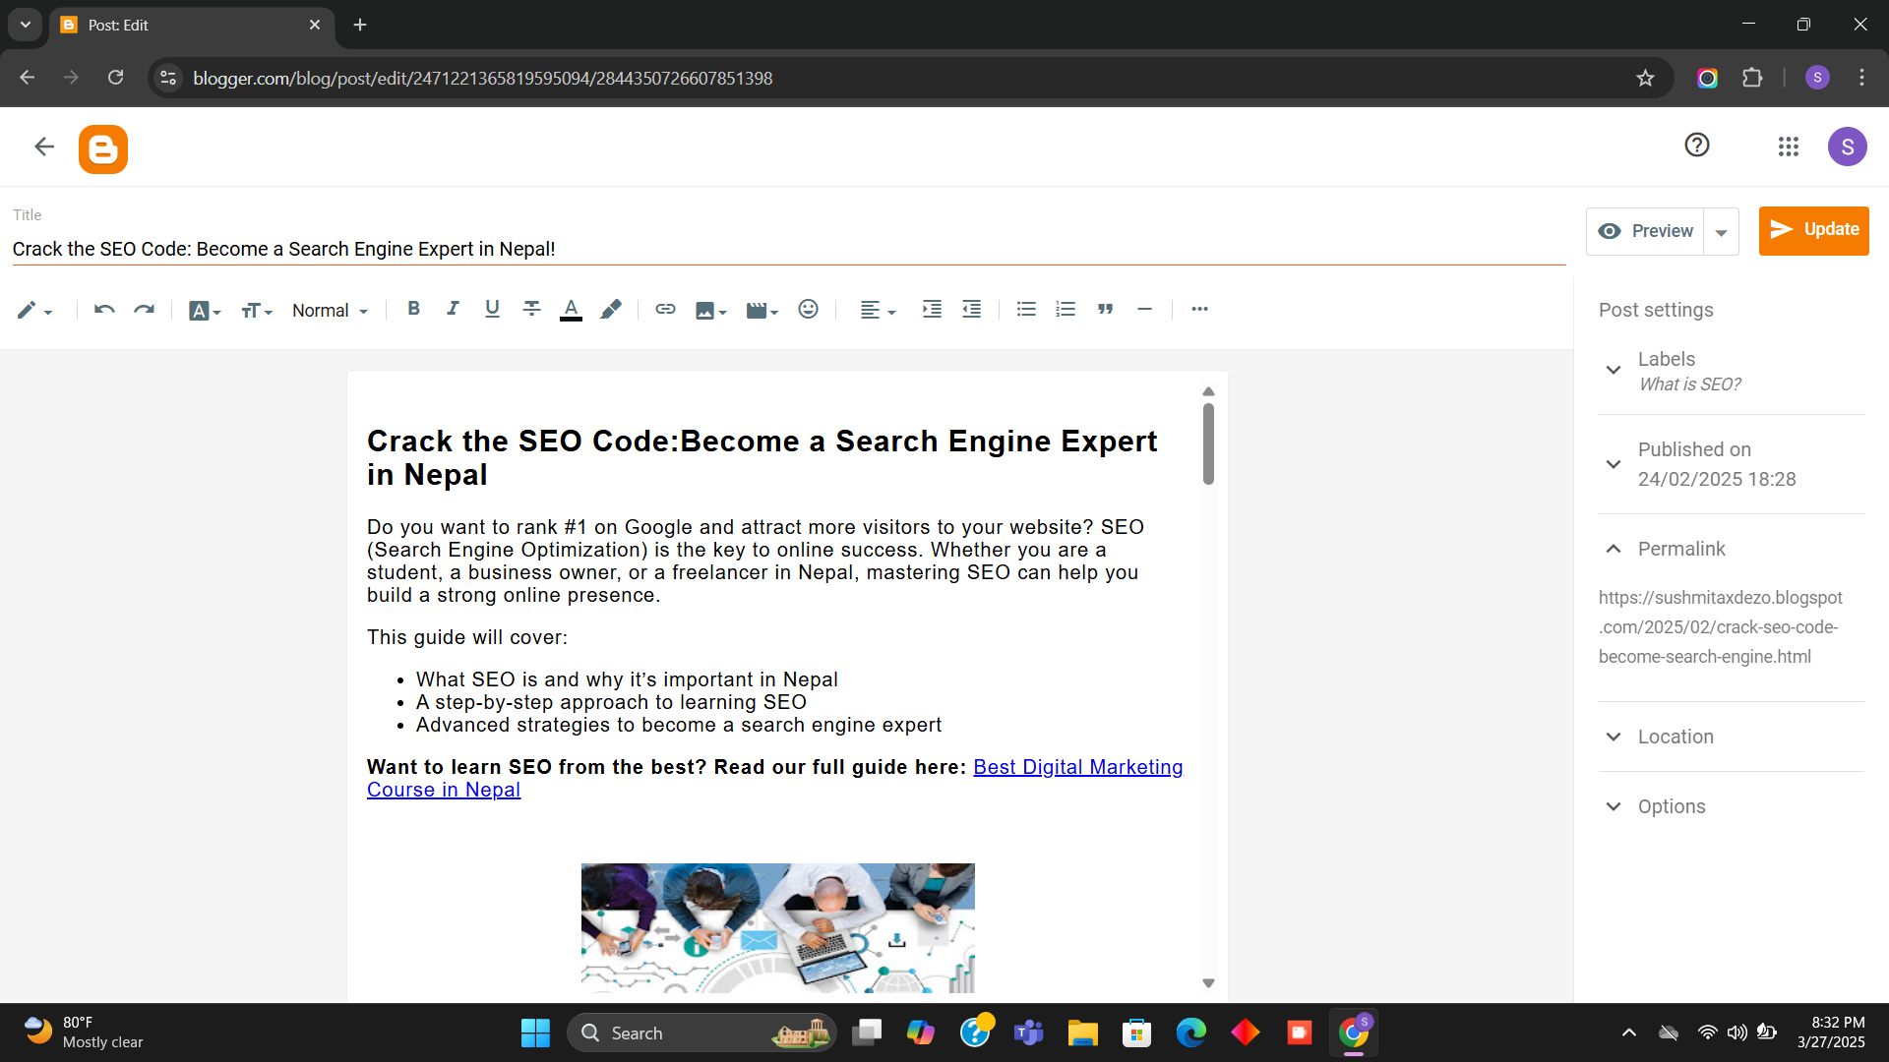

Slide 11
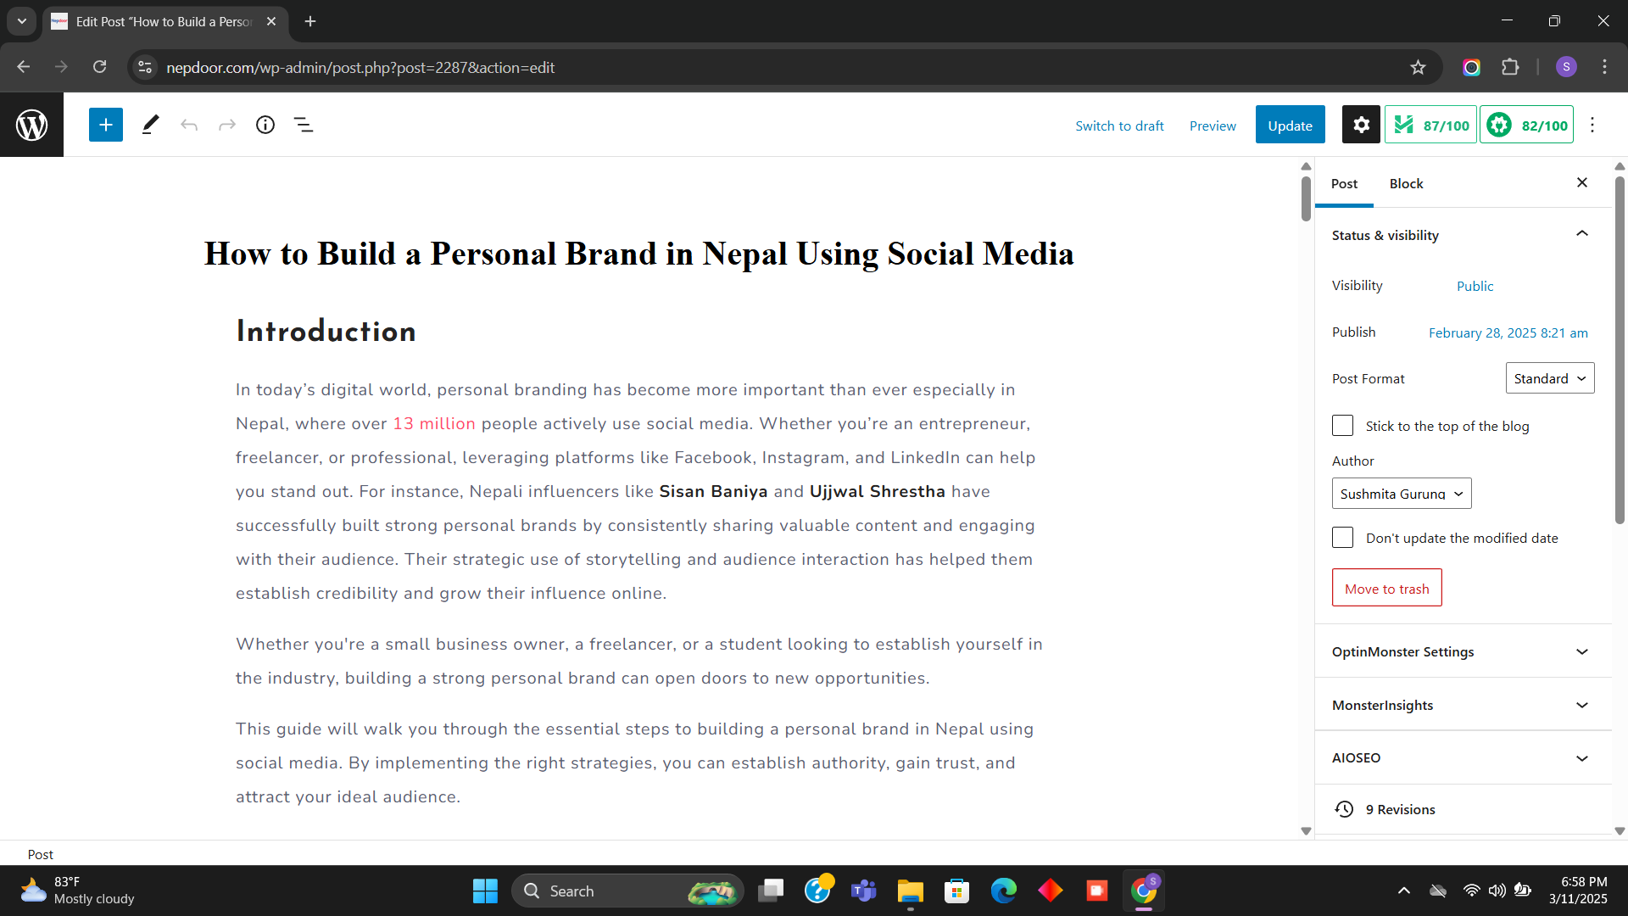

Slide 12
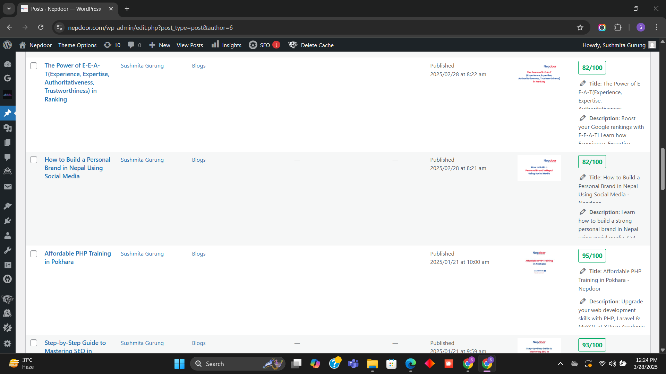

Slide 13
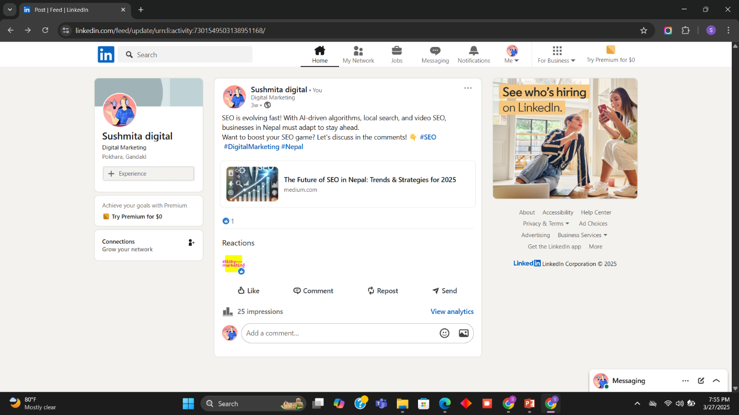

Slide 14
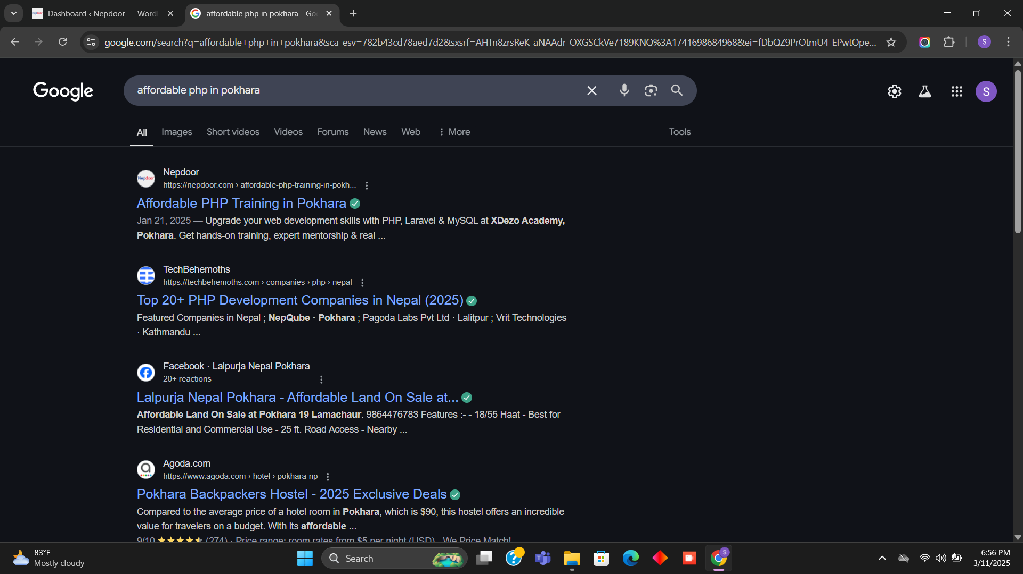

Slide 15
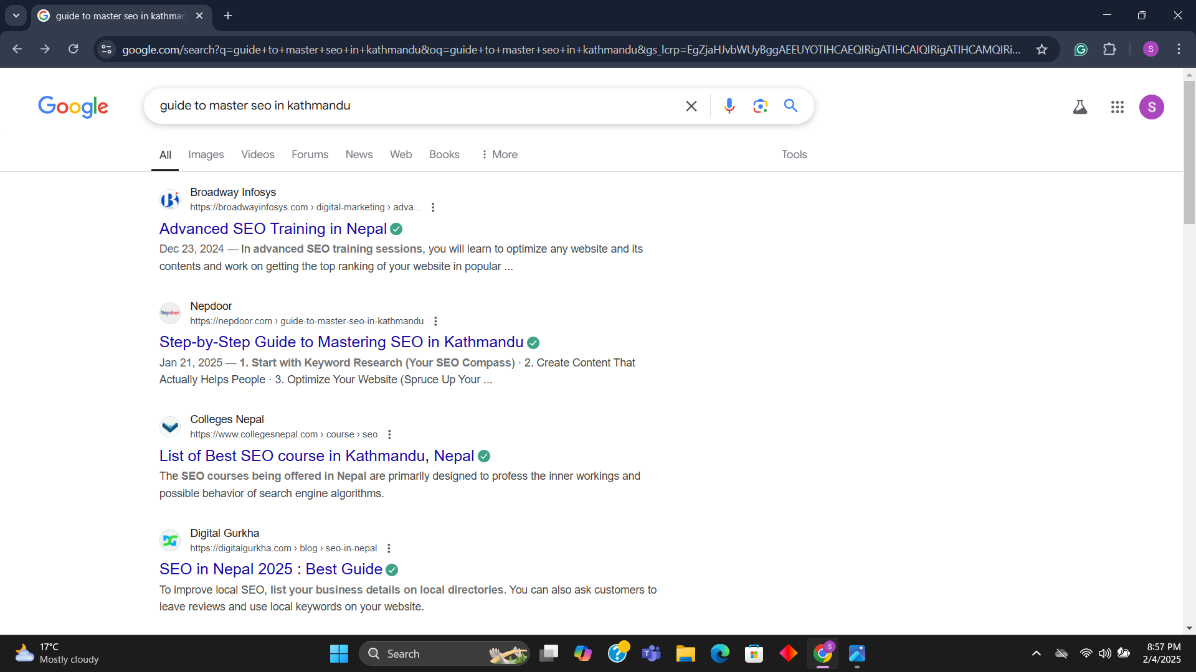

Slide 16
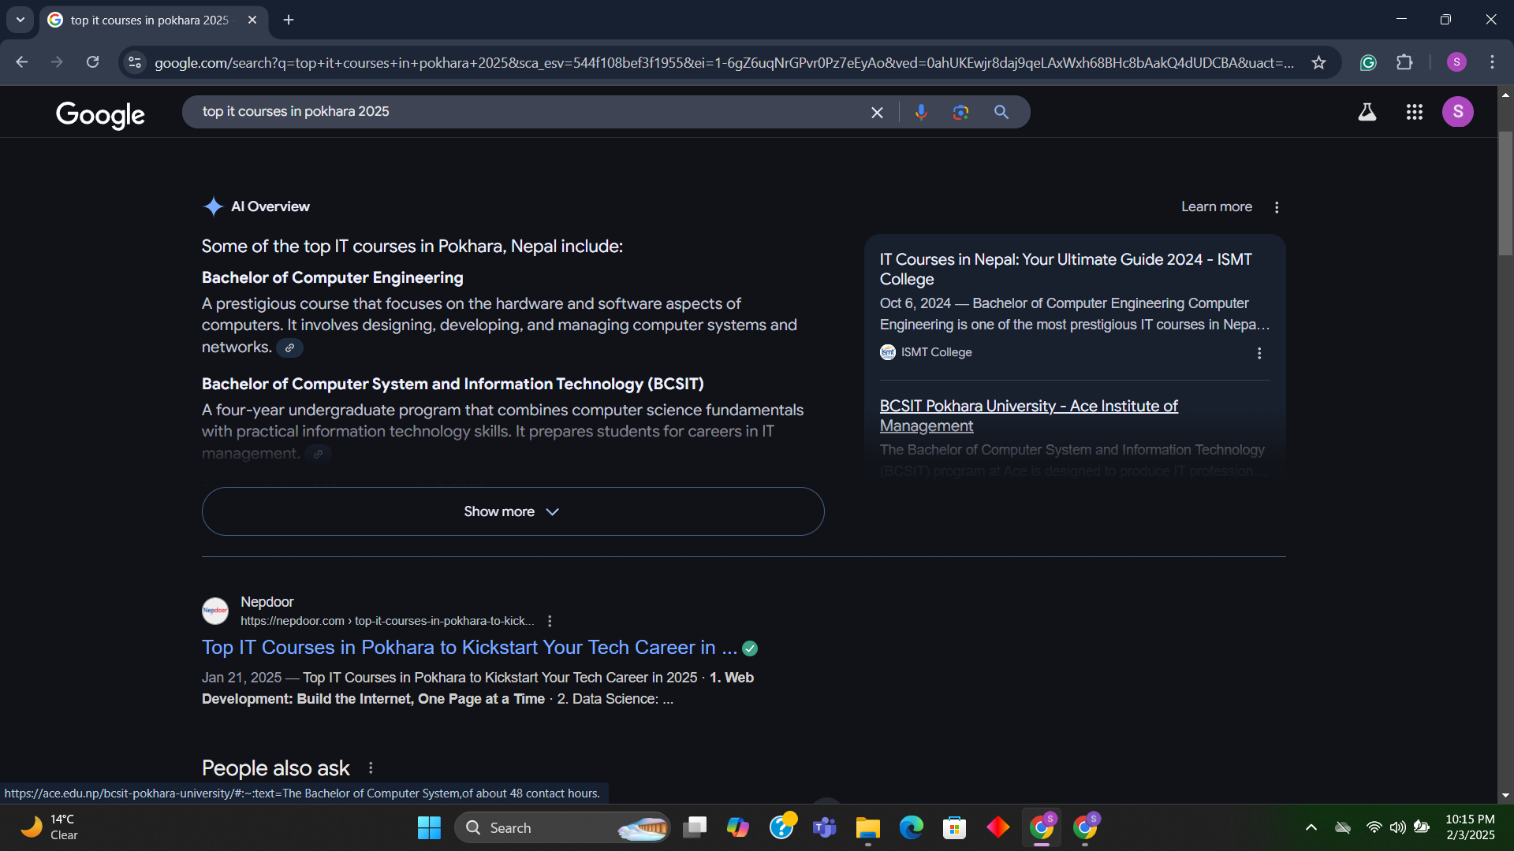

Slide 17
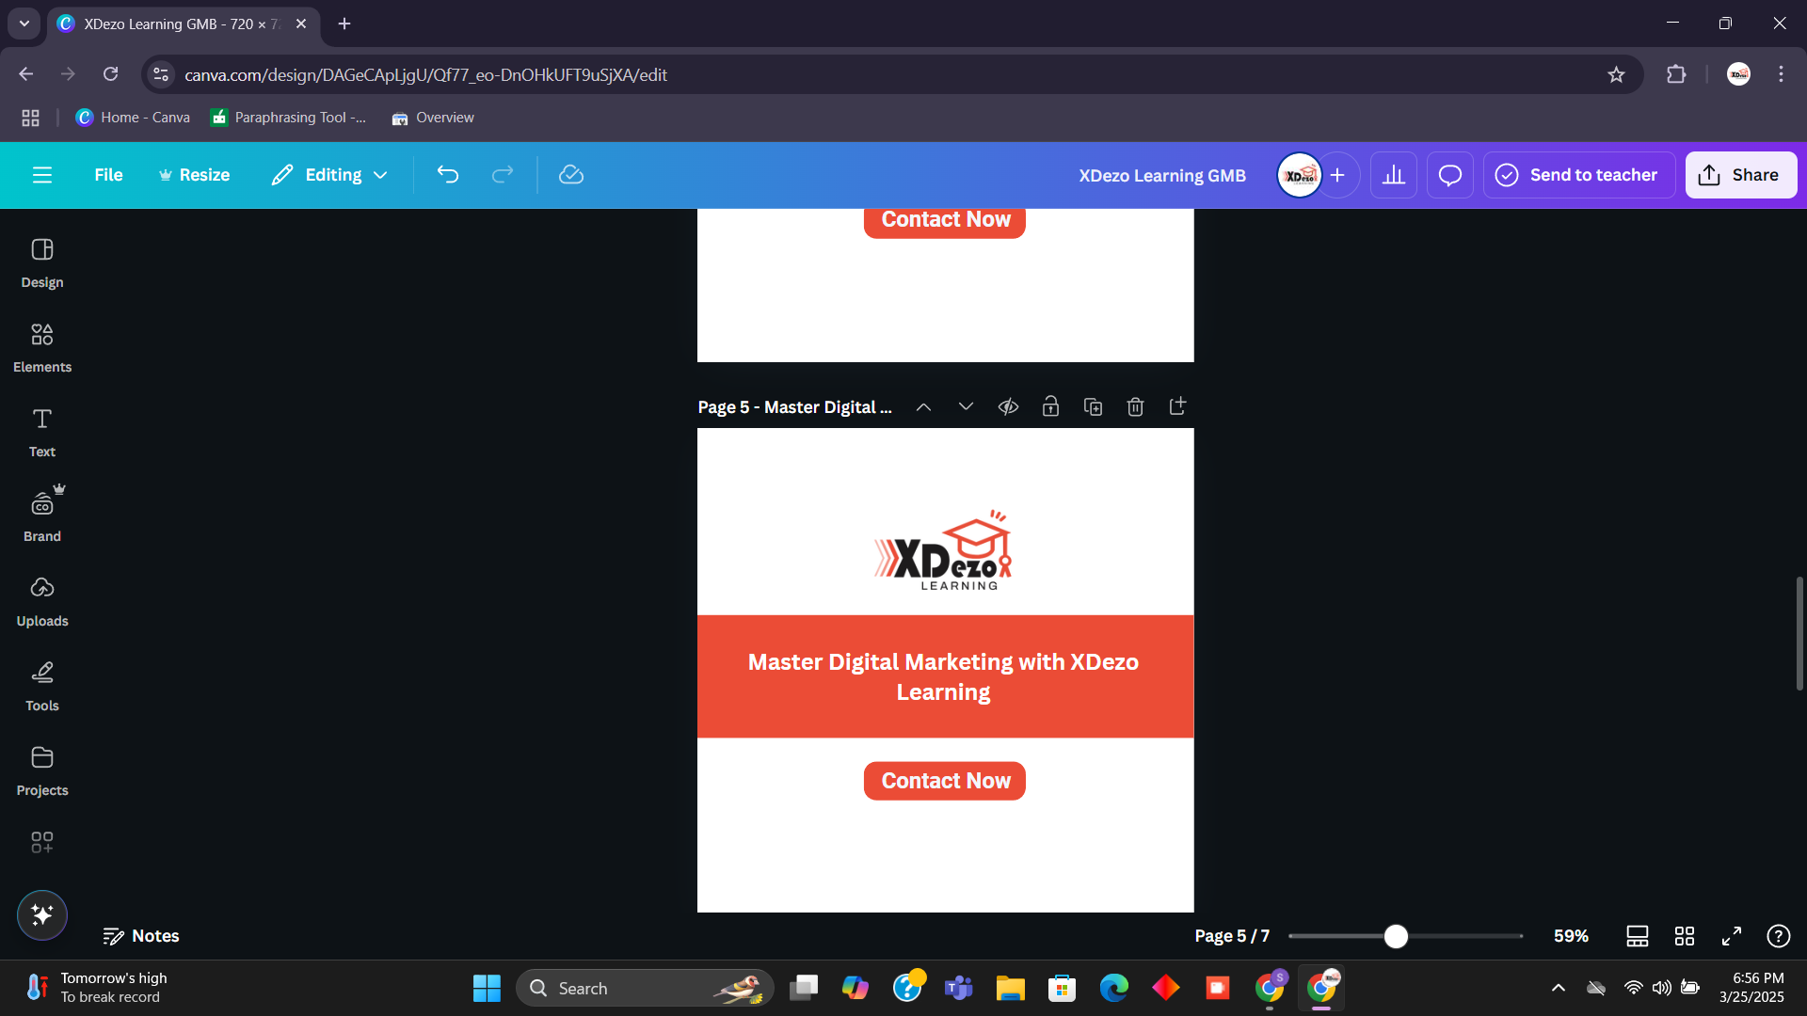
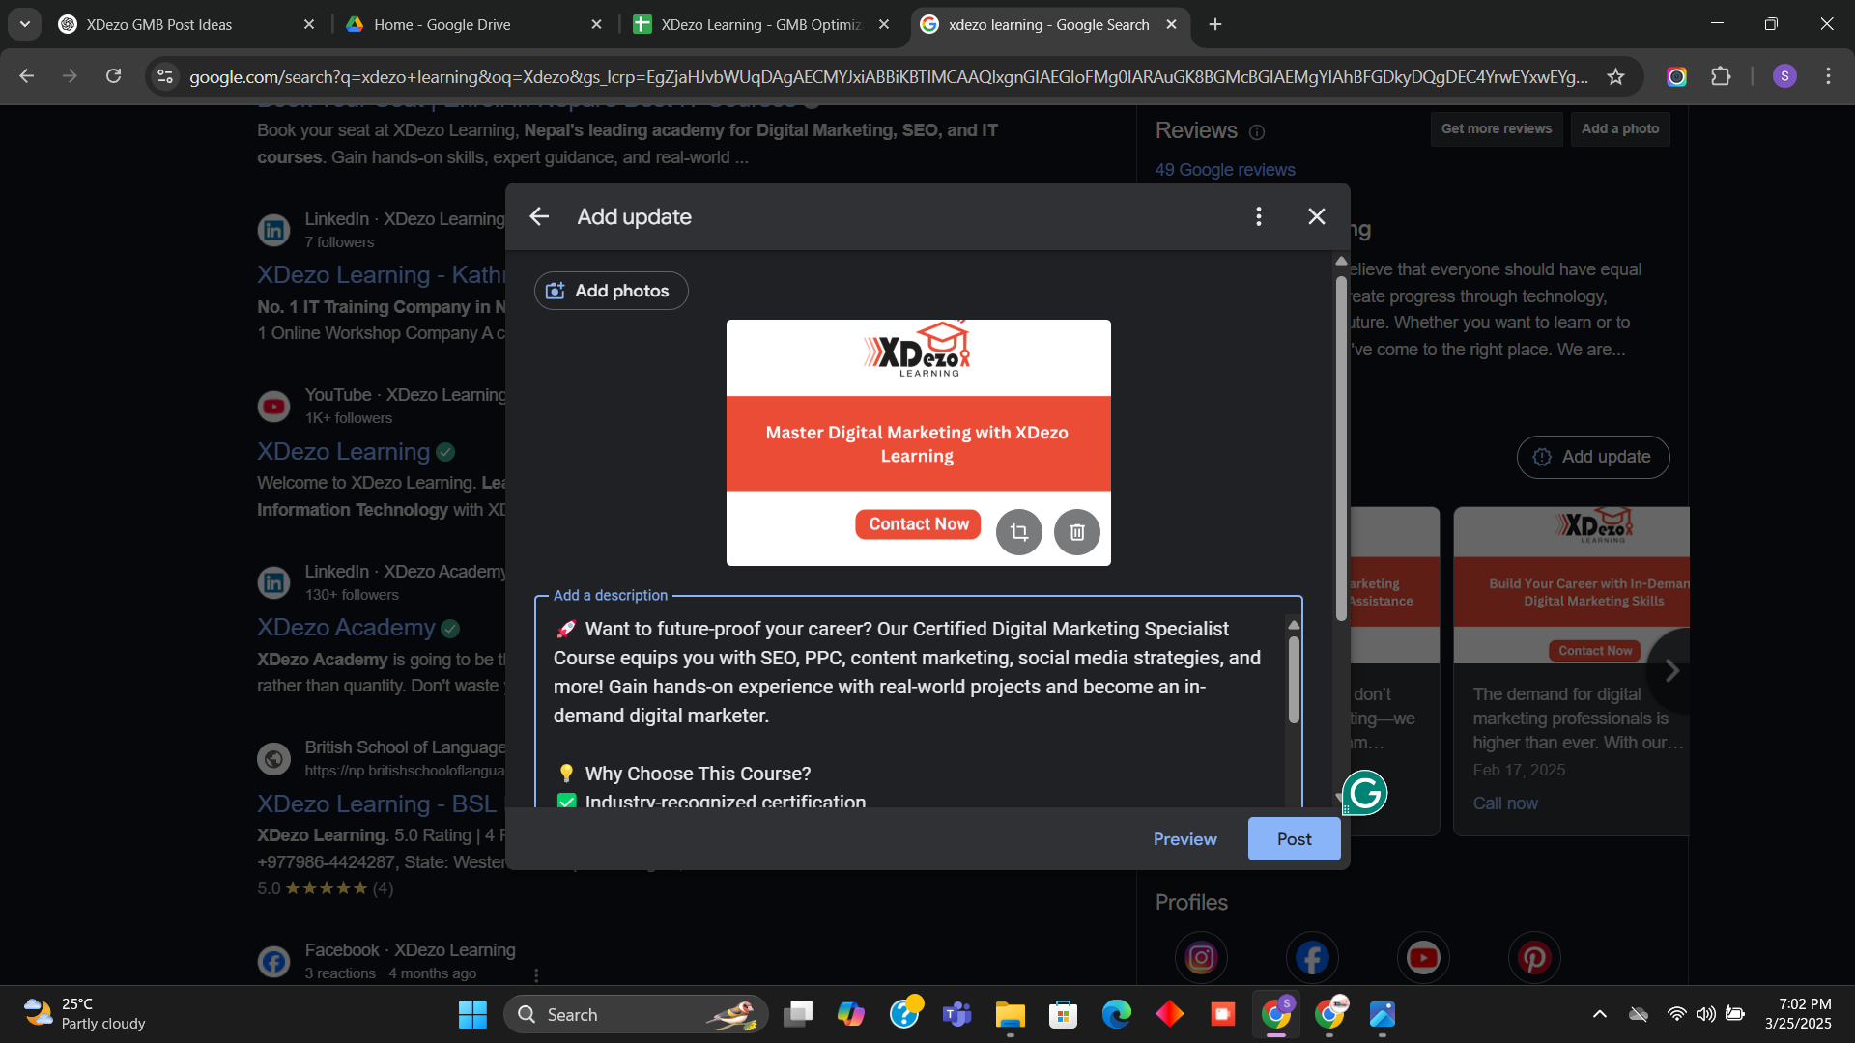

Slide 18
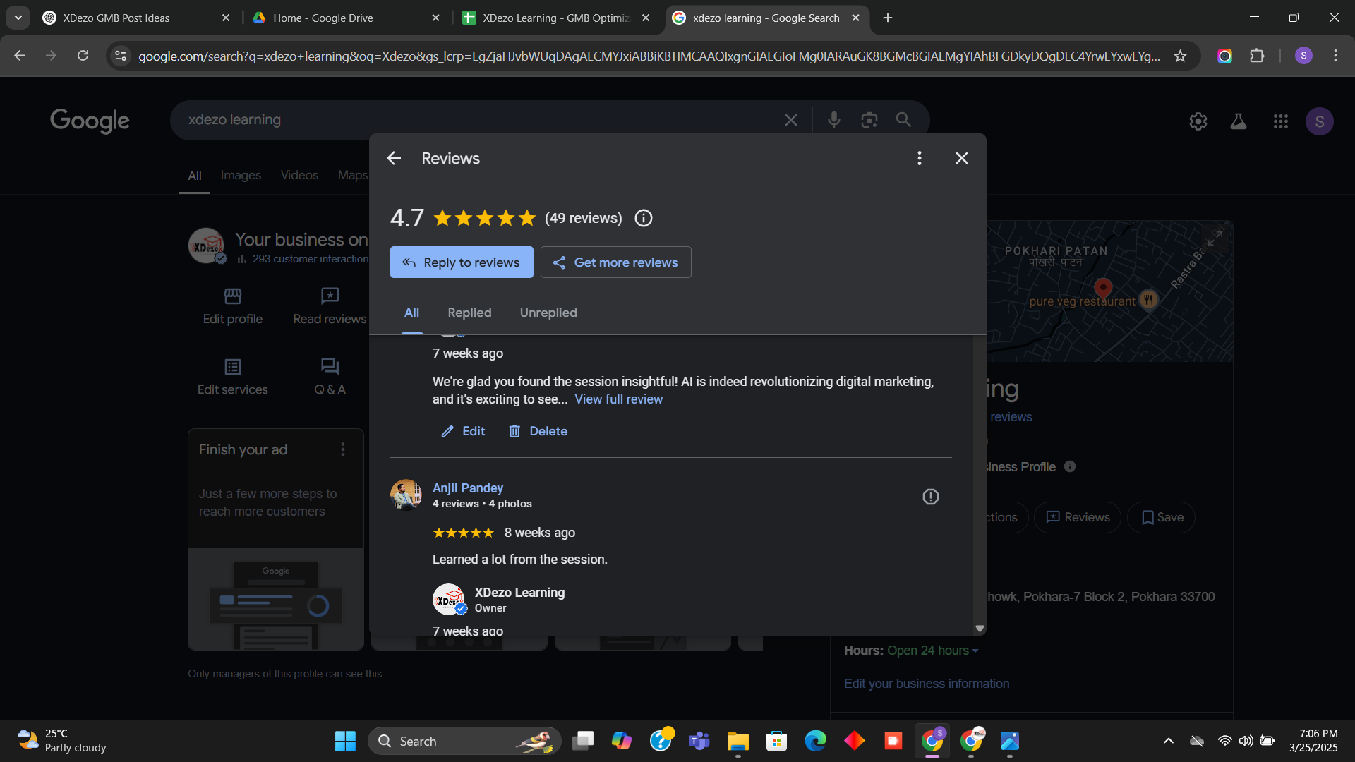

Slide 19
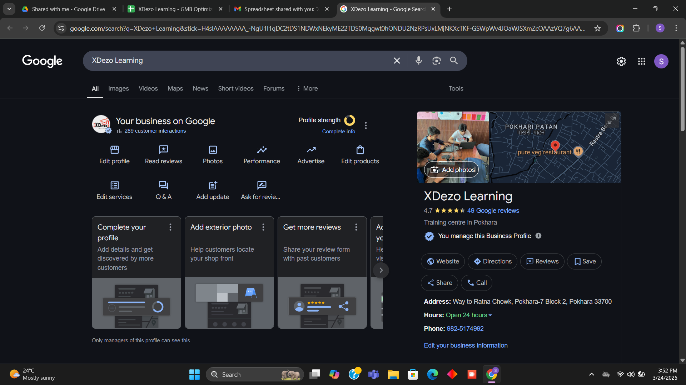

Slide 20
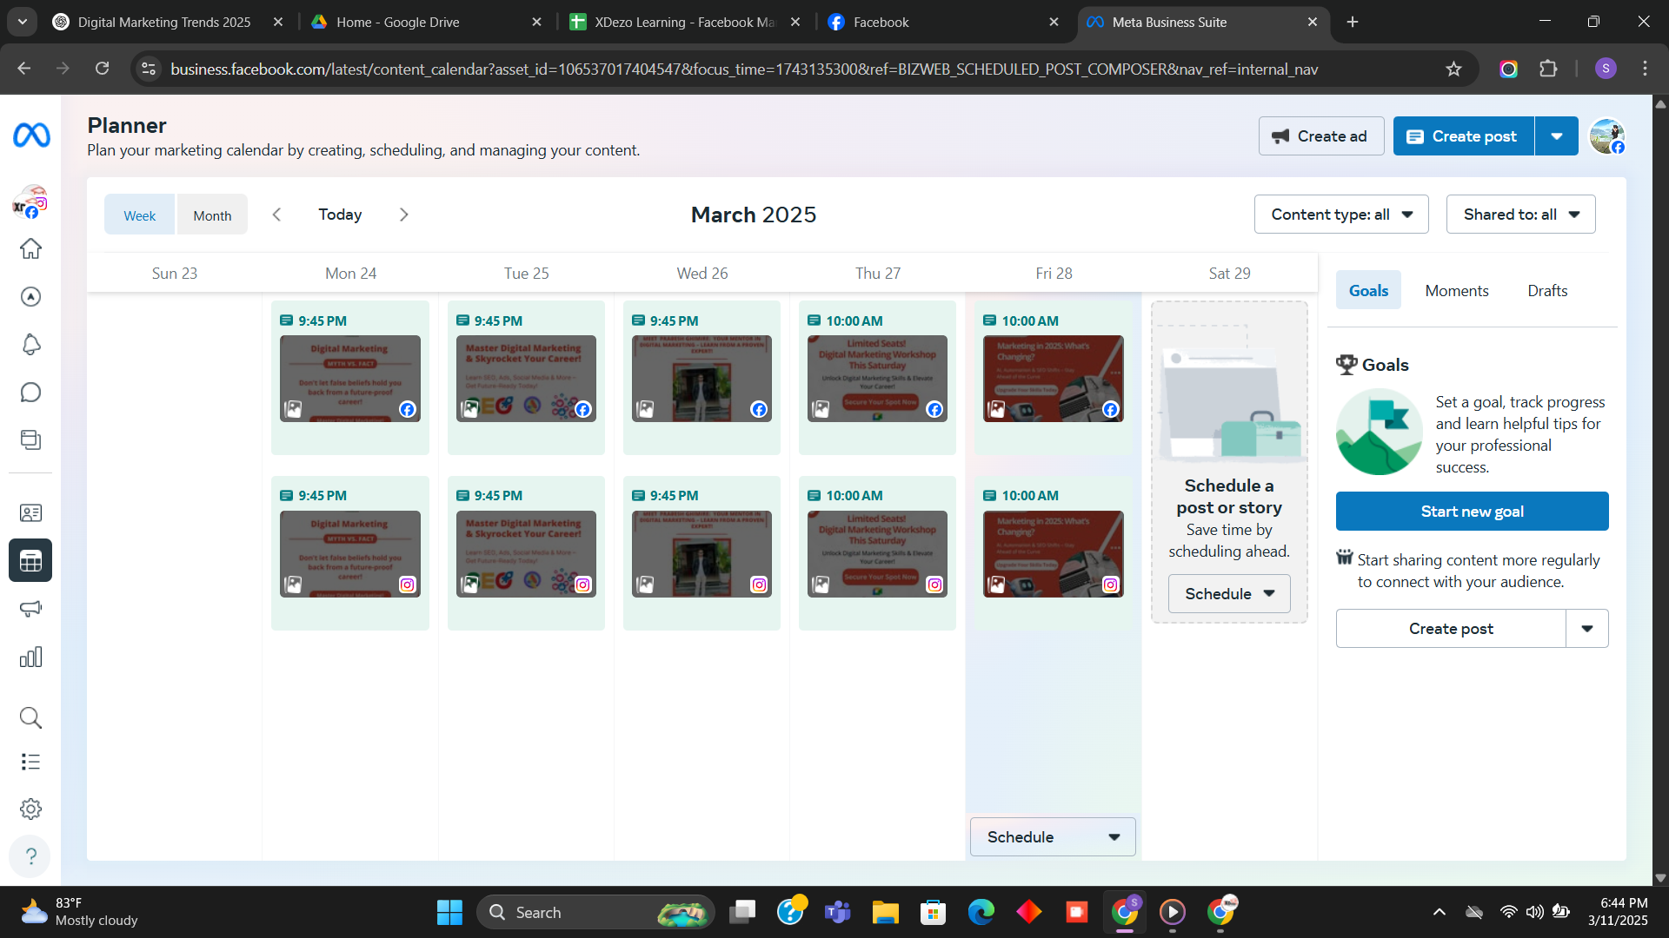

Slide 21
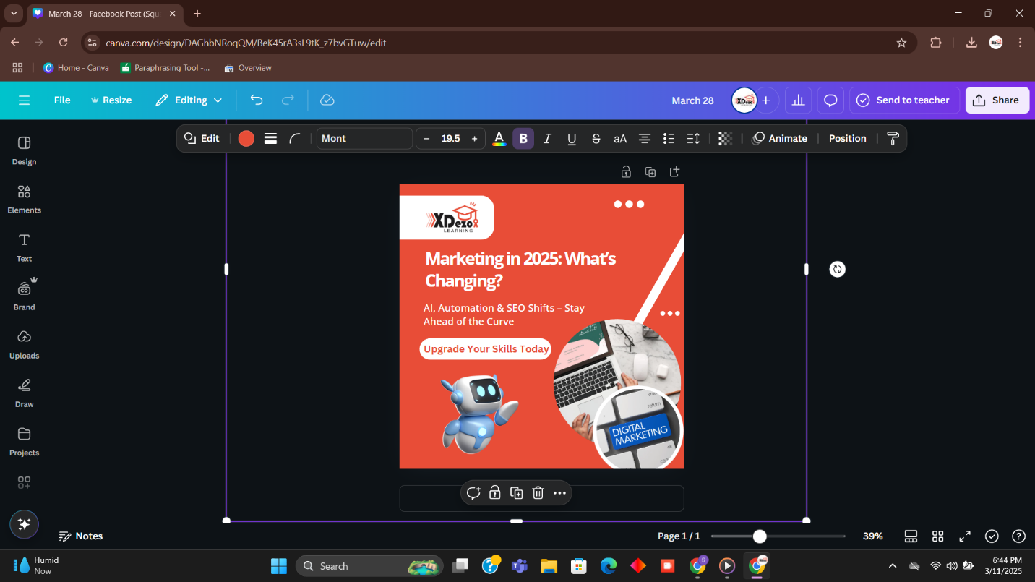

Slide 22
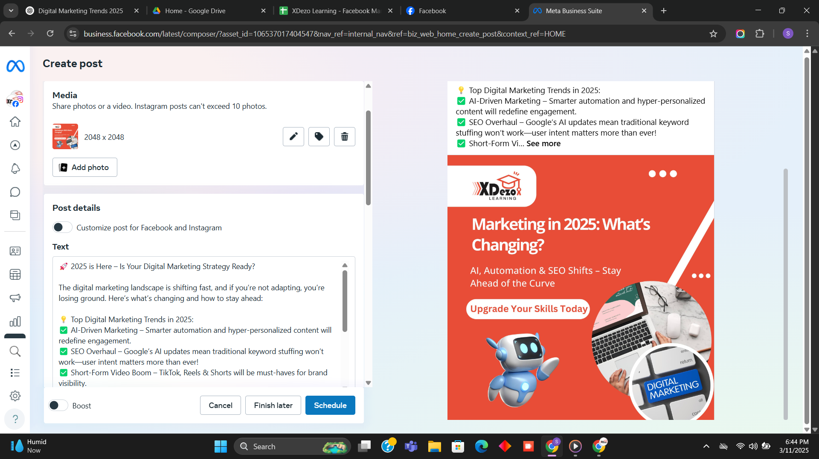

Slide 23
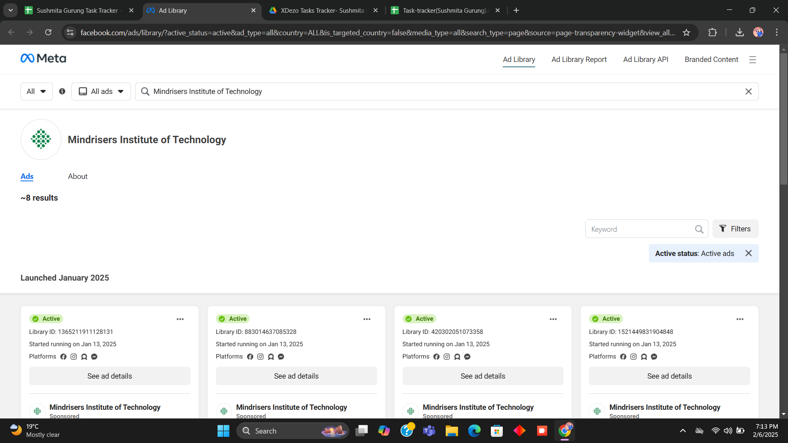

Slide 24
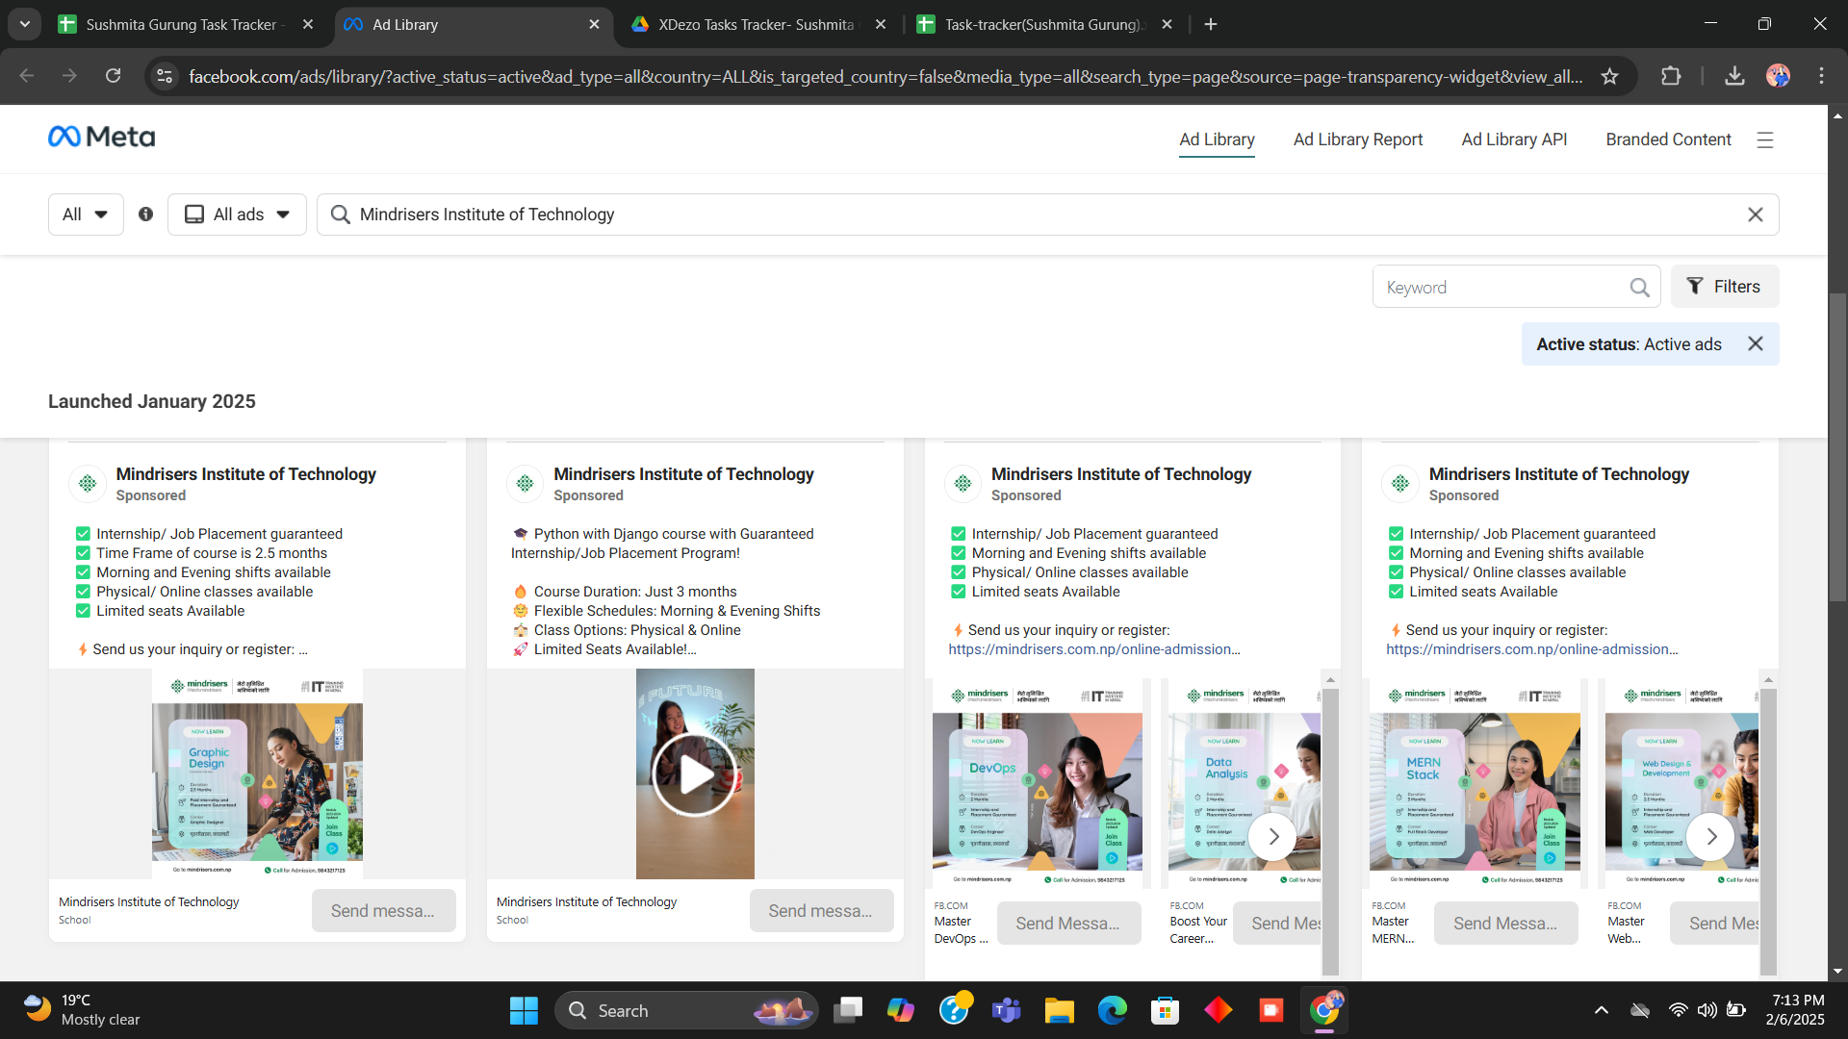

Slide 25
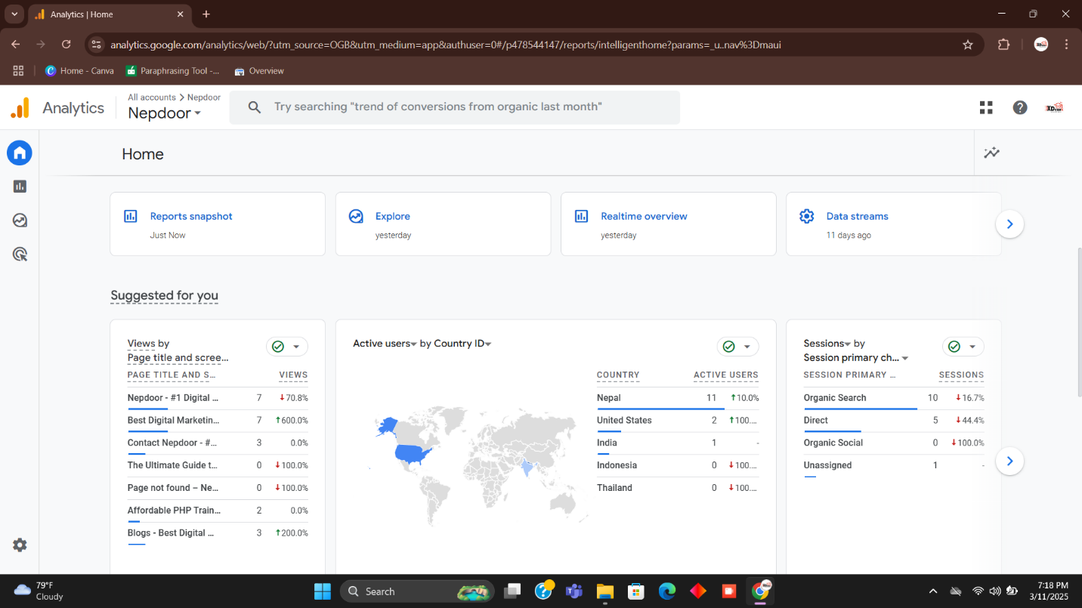

Slide 26
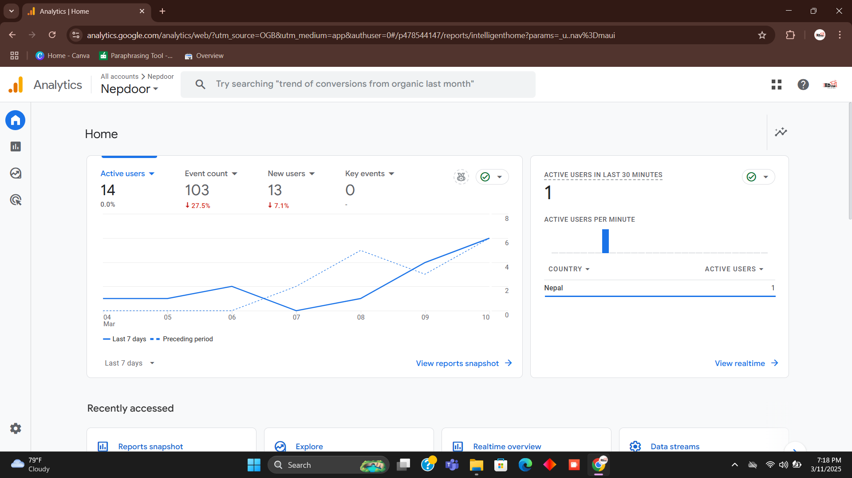

Slide 27
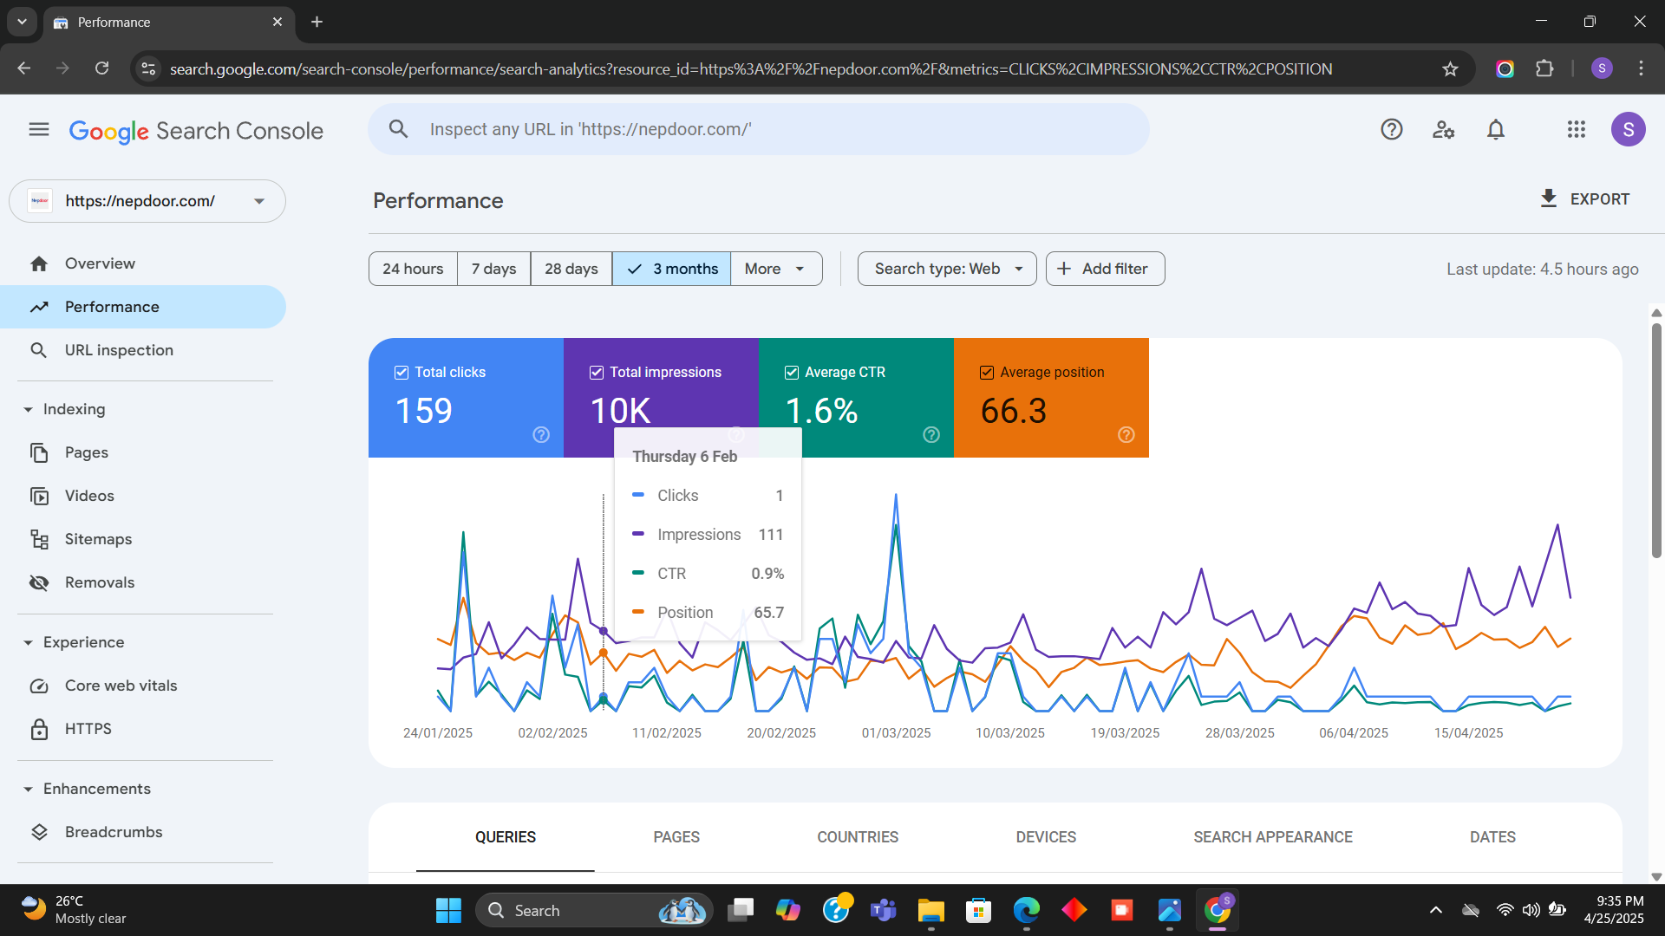

Slide 28
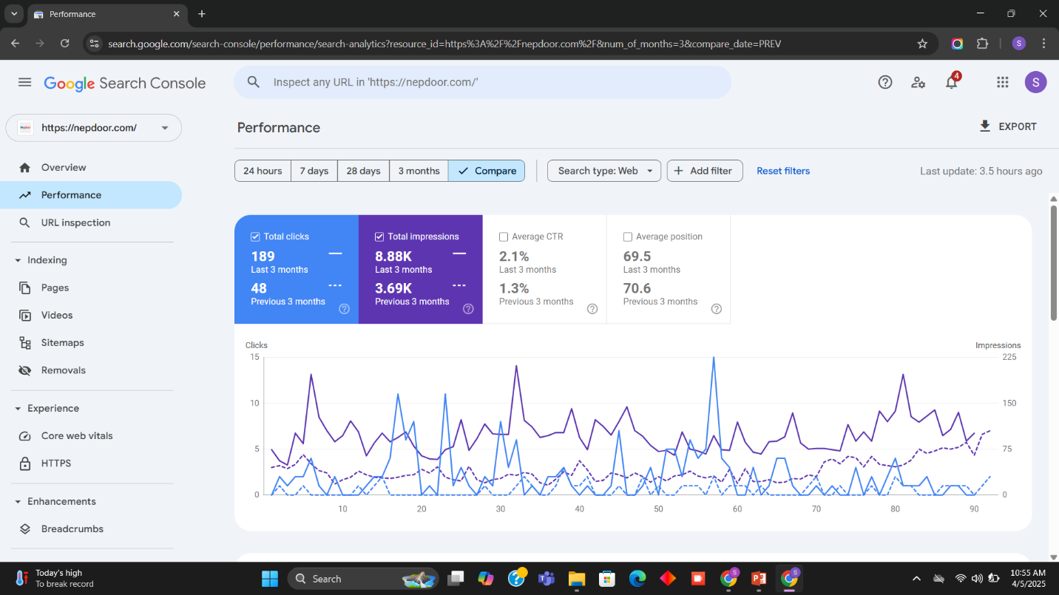

Slide 29
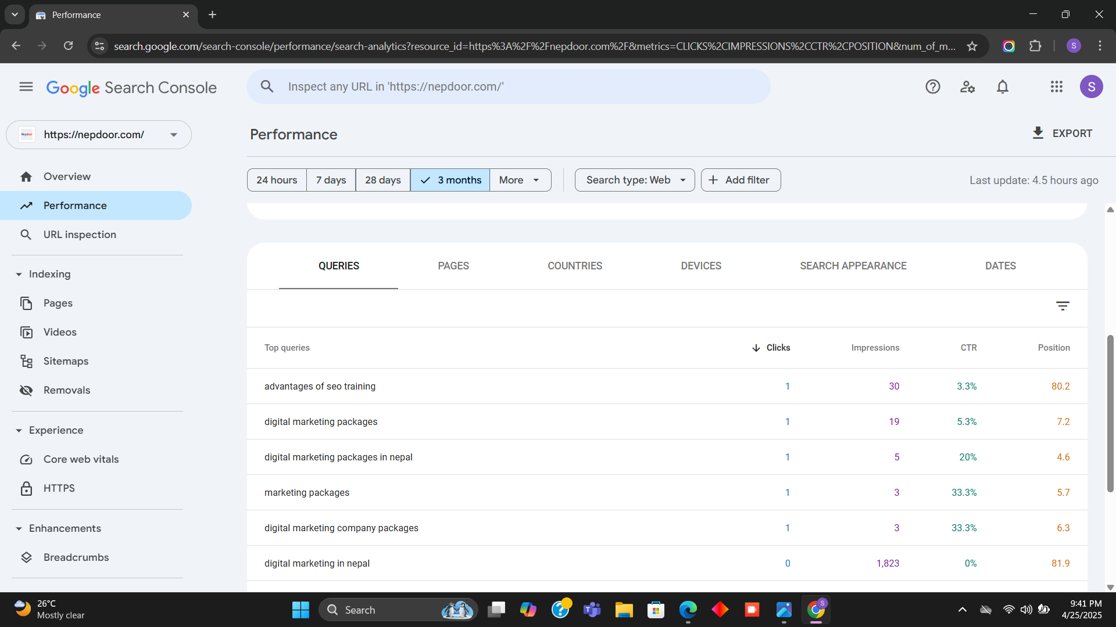

Slide 30
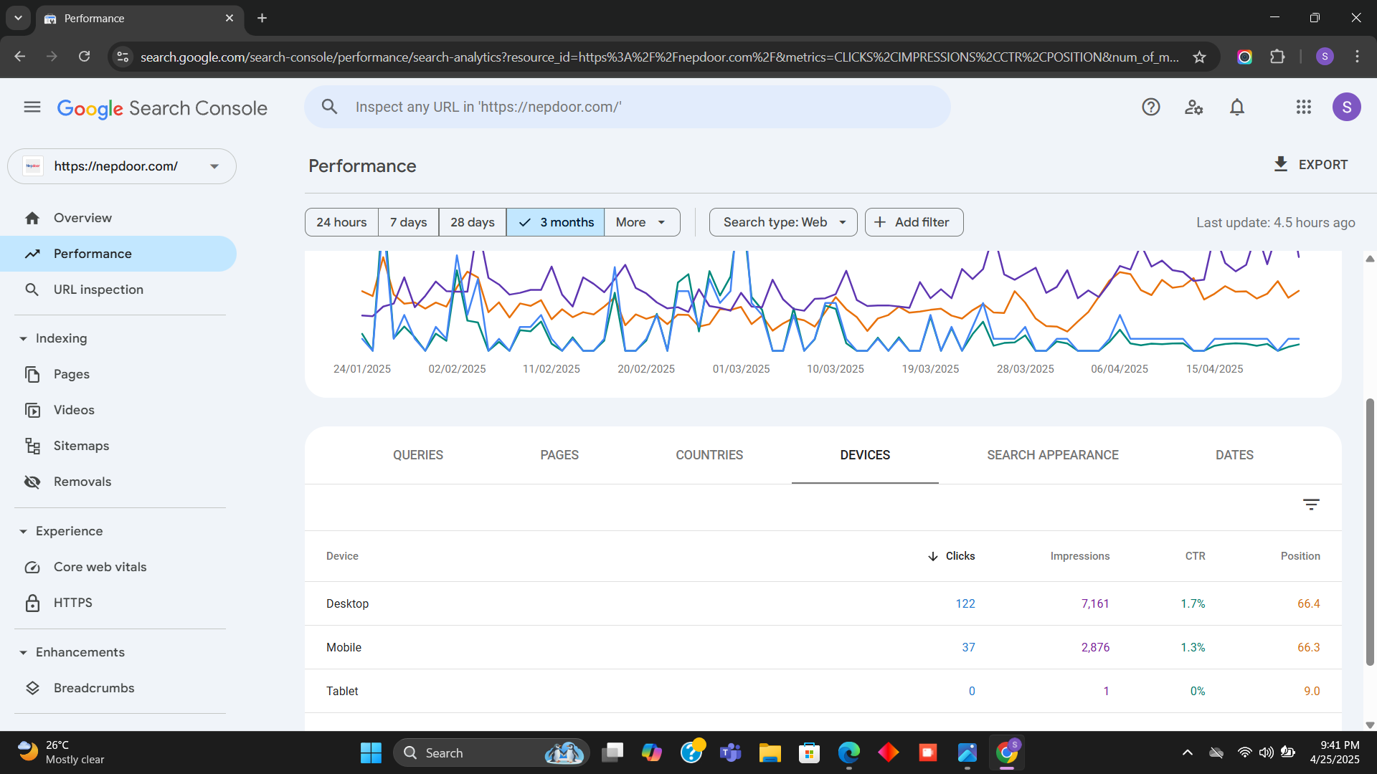

Slide 31
Conclusion
Gained experience in a corporate working environment.
Developed teamwork and collaboration skills.
Learned how to accept and respond to constructive criticism.
Improved interpersonal, communication, and professional skills.
Understood the importance of customer satisfaction as a top priority.

Slide 32
Thank You !

